Slide 1
Task2Do
שירה צ'שלר 323825059
אלמוג שור 207900440
ליאור שיבולי 212608699
יובל בראור 214329633

Slide 2
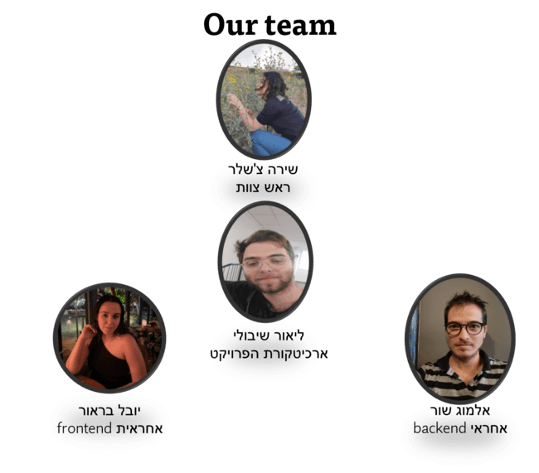

Slide 3
Our Project Aim
This project aims to with smart project management to teams.
Aims to allow workers to be associated with managers and be in their projects (to get tasks and deadlines).
Also, we wish to let workers divide their tasks into subtasks, update task statuses, and send requests to managers.

Slide 4
Current State Analysis
The problem space: inefficient project management (from both manager and worker point of view)
Today’s situation: resource management (such as time, tasks, and employees) is still done in a way that can cause project failure
Similar apps:
-Todoist (one can give tasks and subtasks for itself)
-Futuramo Tasks (Team leader can give tasks to team members)
Our improvement: Let the manager give assignments but also let the workers manage their time smartly.

Slide 5
דרישות מערכת:
Creating projects
Status update
manager
worker
Dividng tasks into subtasks
Assigining tasks
Sending requests

Slide 6
מחיקת/ שינוי משימה קיימת | נתינת משימה למשתתף | הרשמה והתחברות למנהל משימה | פרופיל מנהל משימה
(*) פתיחת בקשה וצפייה בבקשות | עדכון סטטוס למשימה קיימת | הרשמה והתחברות למשתמש | פרופיל משתמש
Check לסיסמה מוצלחת | שמירה על סיסמאות מוגנות בDB | אפשרות הרצה על מגוון מערכות הפעלה | עדכונים למייל בזמן אמת

Slide 7
User stories
Create projects:
I as a manager of several teams want to be able to create different projects for each one in order to organize them
Password reset: I as any user want to reset my password to
Dividing subtasks: I as a worker want to divide one task into subtask that are easier to complete

Slide 8
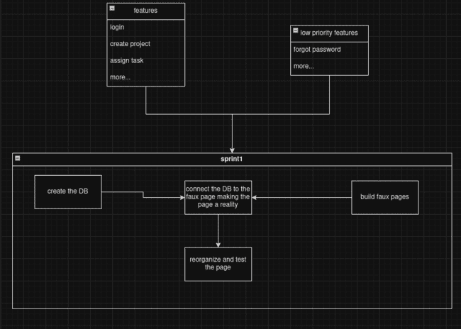
AGILE -two major sprints each spanning about two weeks

Slide 9
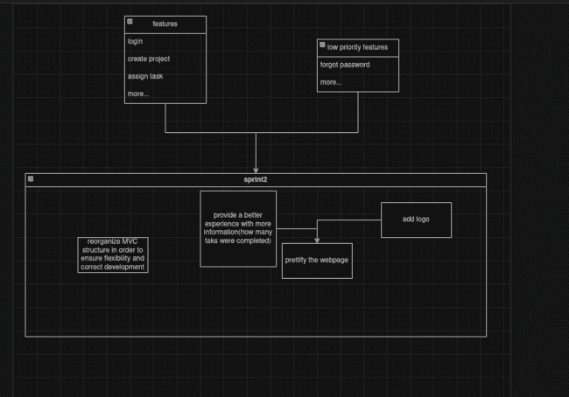
Sprint 2

Slide 10
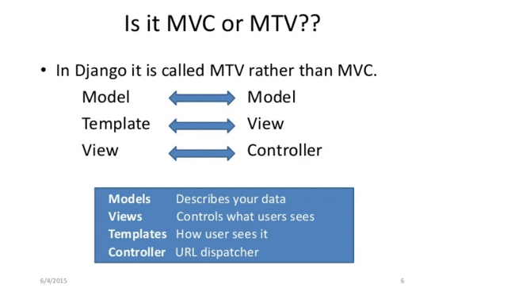

Slide 11



Slide 12

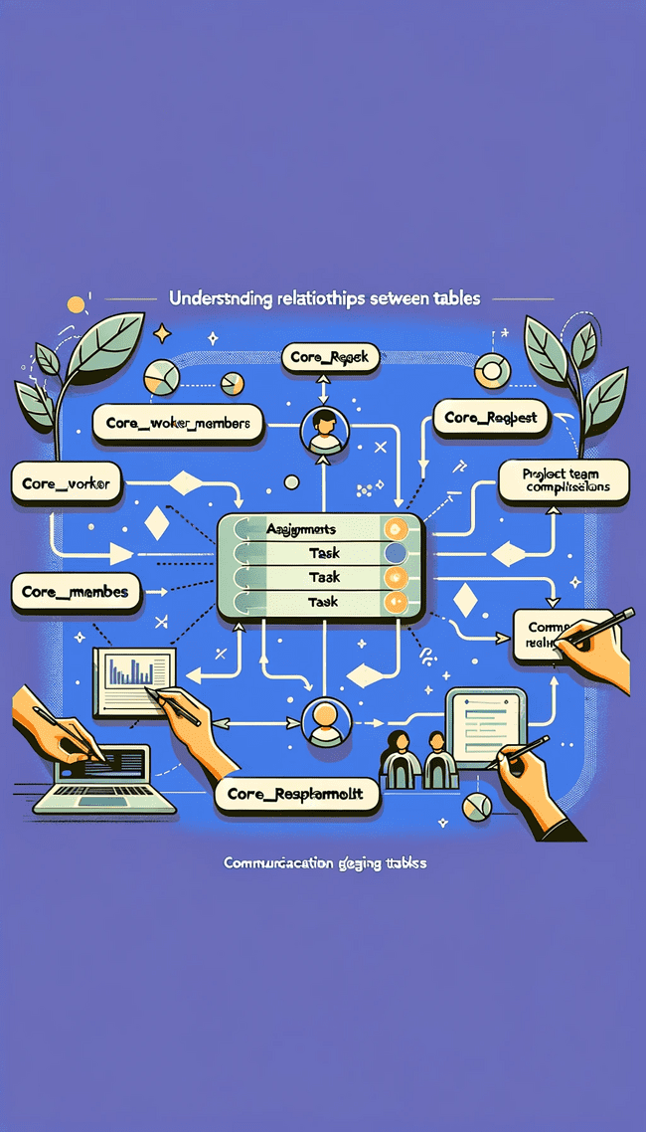
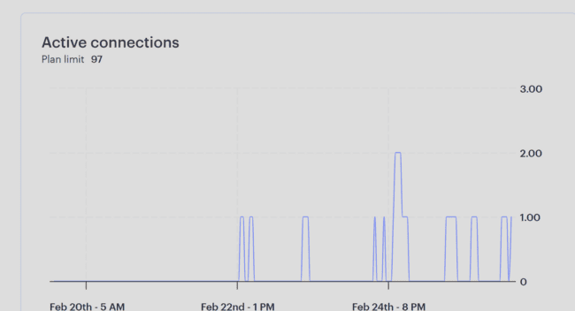
Backend and DB Service Presentation

Slide 13
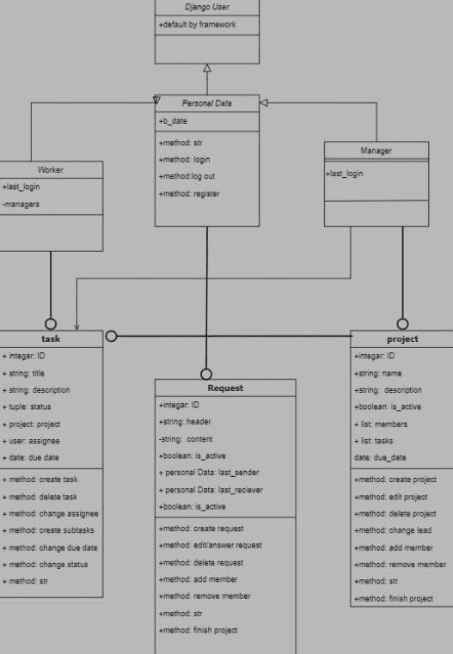
Class Diagram

Slide 14
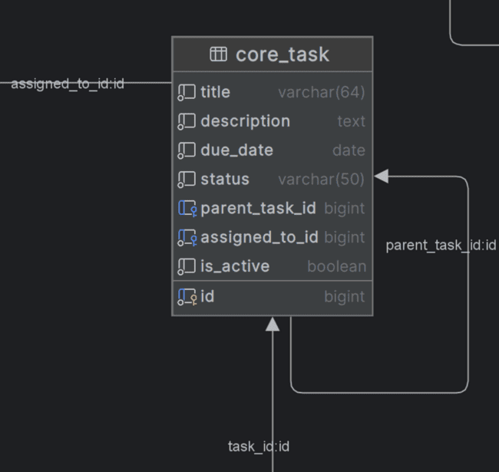
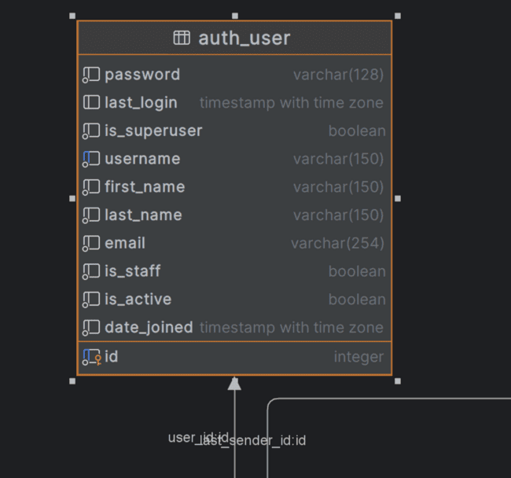
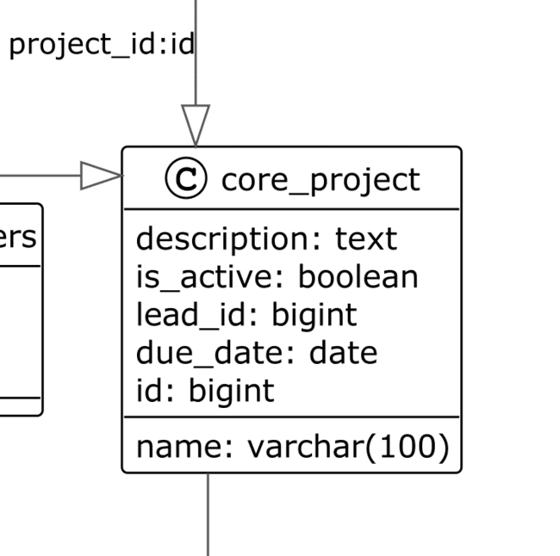
Detailed Table Structure

Slide 15
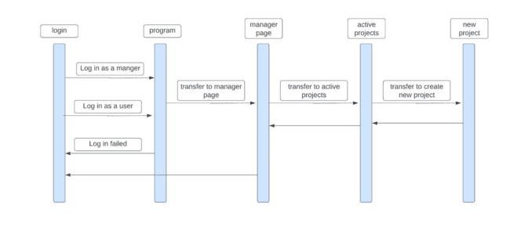
Sequence Diagram

Slide 16



Backend System Structure
Models

Slide 17
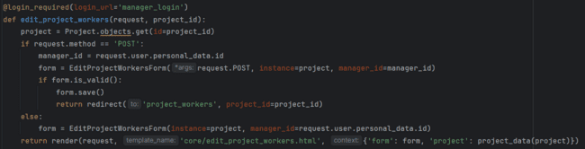
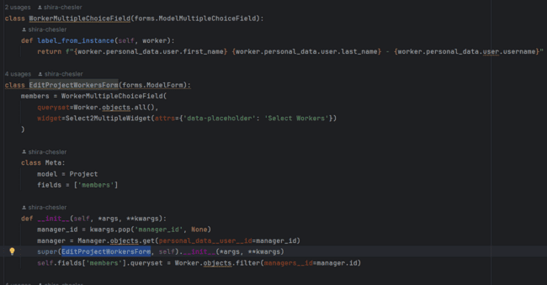
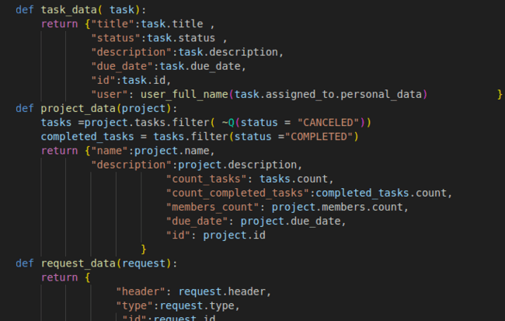
View with a Form (Posting into the DB and Authentication)

Slide 18
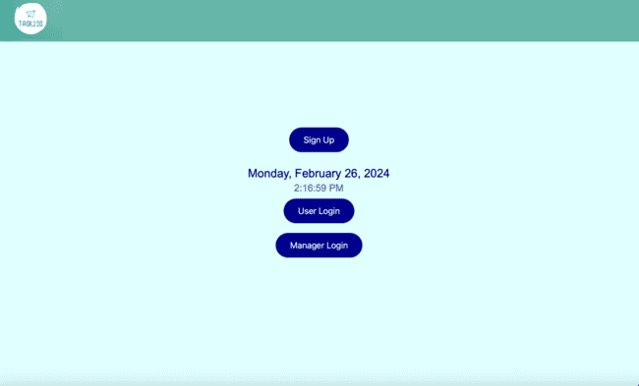
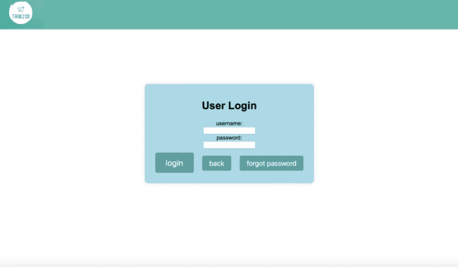
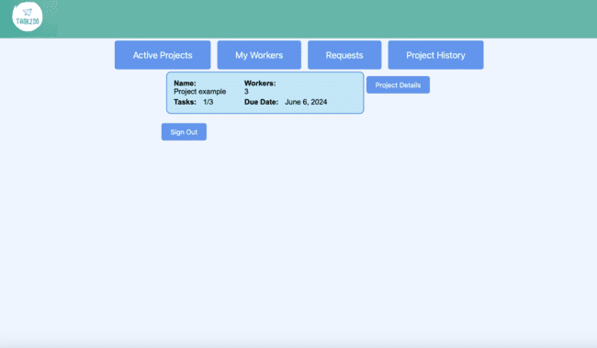
Front-End
Html
CSS

Slide 19
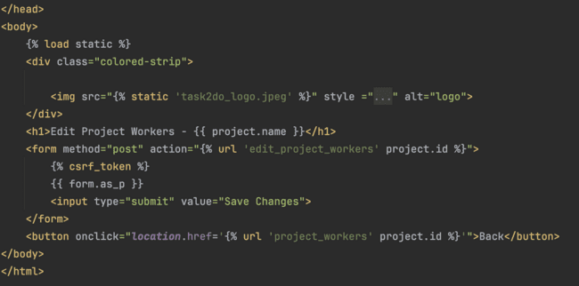
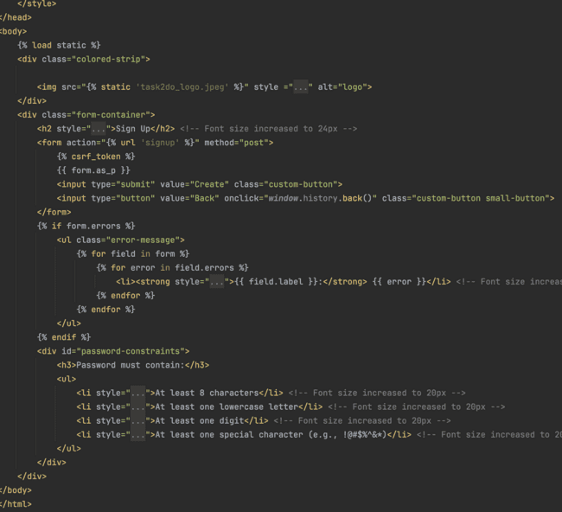
Html
sign-up
Edit project workers

Slide 20
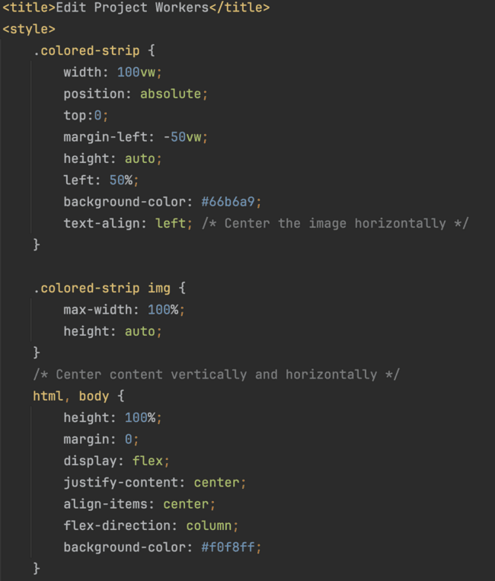
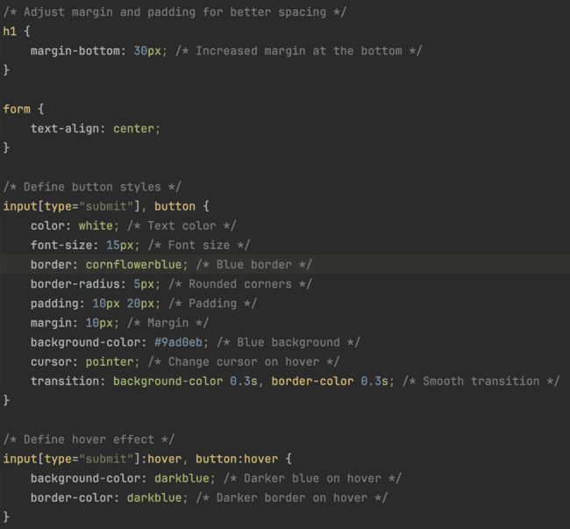
CSS
Edit project workers

Slide 21
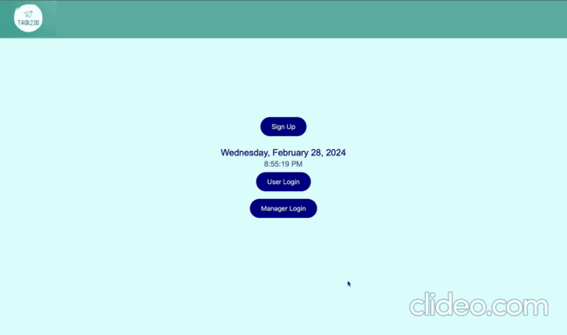

Slide 22
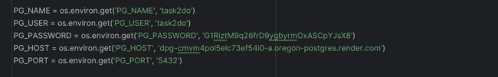
פערים

Slide 23
Thank you for your time and attention 🙂

